Slide 1
ORGANIZATION : QZENSE LABS
INNOVATION HACKATHON
CHALLENGE 6: QUALITY ASSESSMENT

Slide 2
CONTENTS
Team Name and Members
Challenge Statement
Challenge Requirement
Approach
Solution
Banana Quality Assessment (Case)
Features to be Added

Slide 3

Team
Team Name : Qzense Labs
Team Members : Srishti Batra, Sarah Sheryl, Amith Doreswamy, Abhishek Kumar, Sachin Shekhar R. , Himanshu Saha, Rajat Suman

Slide 4
Challenge Statement
To develop a prototype for quality assessment of farm products throughout the agri value chain.

Slide 5
Challenge Requirements Given
Define the parameters for quality assessment / assaying for various categories such as fruits, vegetables, grains, dairy and animal produce, using standards set by DMI & others and followed by eNAM and others;
Define a quantitative quality grading scale to assign quality score to various categories of farm products based on the parameters defined above;
Develop a prototype for assessing quality using text attributes (e.g. determine shelf life using attributes such as picked date, weather, no. of days stored, firmness, etc.) and (optionally) visual attributes through image processing / machine vision algorithms.
The prototype should assess quality for one or more categories of farm products using a combination of text and visual attributes, with facility to integrate external data and (optionally) image feeds to support validation of quality of farm & dairy produce;

Slide 6
Challenge Requirements Given Contd….
Develop an intuitive interface that allows a user to enter input variables such as category of farm & dairy products and for which the output generated includes the quality assessment parameters and the quality score;
Using the quality assessment prototype above, create an automated mechanism to validate and verify the quality of the farm produce that passes through the value chain from farmer to the end customer, thus facilitating traceability of the produce quality across the value chain while creating a robust & singular source of truth for quality validation of produce.

Slide 7
Approach
Requirement 1
Created an input channel (Mobile App) for commodities taken from quality standards data shared by NABARD Hackathon team
Requirement 2
Created a data frame using the dataset provided by NABARD repository.
Developed a prototype mathematical model that predicts the qualitative rank and shelf life
Requirement 3
Created a mobile application
Requirement 4
Developed a QR Code system to track Commodities

Slide 8
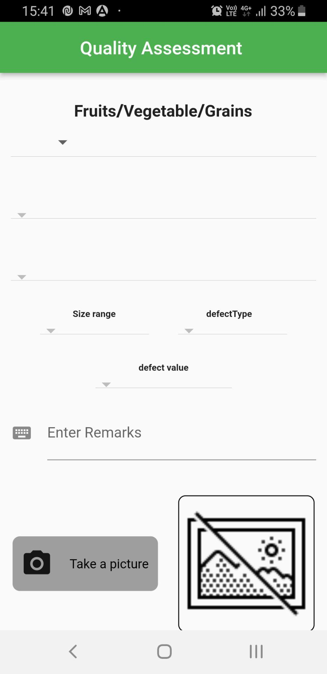
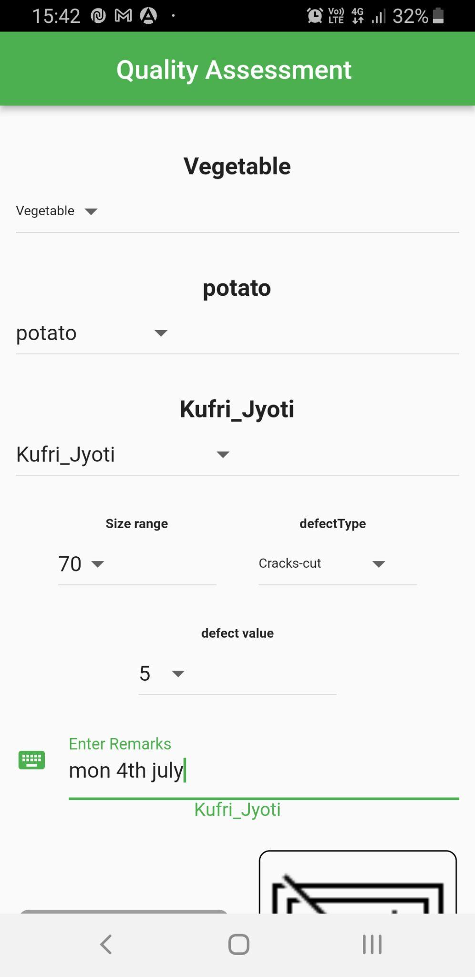
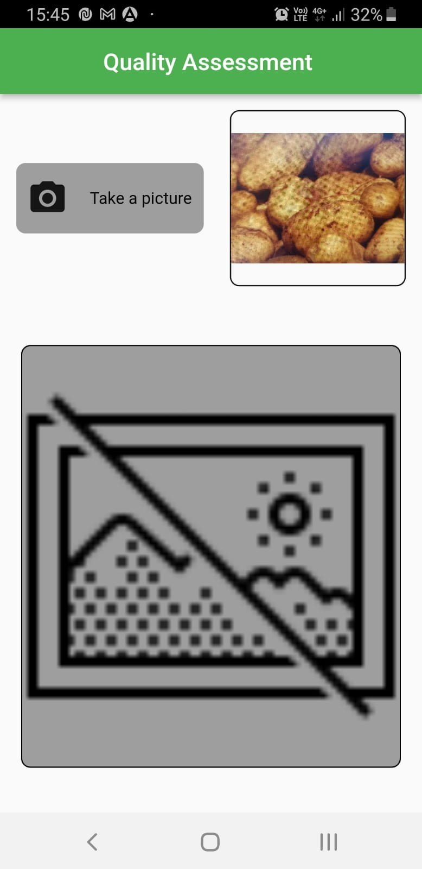
Solution
Input fields included
Type of commodity
Commodity
Variety
Size range
Defect type
Defect value
Fill the details
Take a picture of commodity

Slide 9
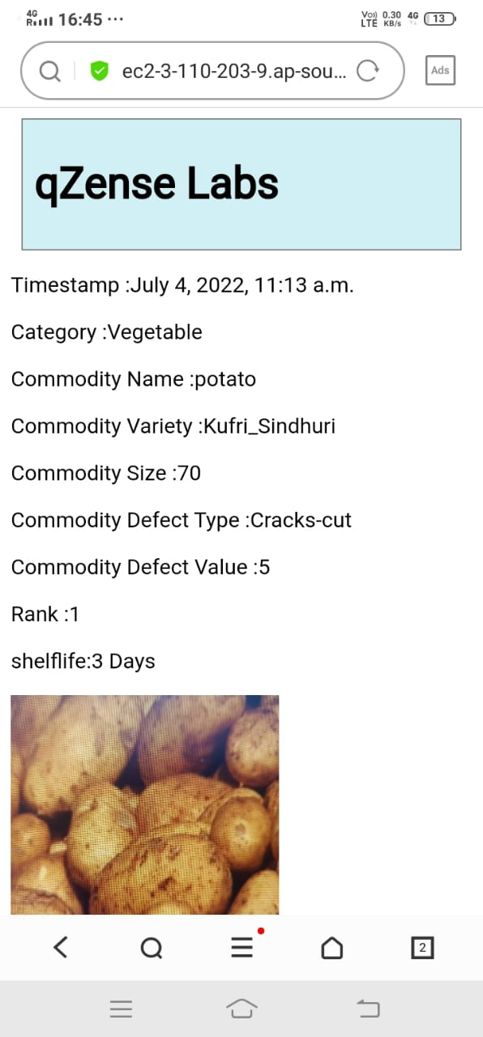
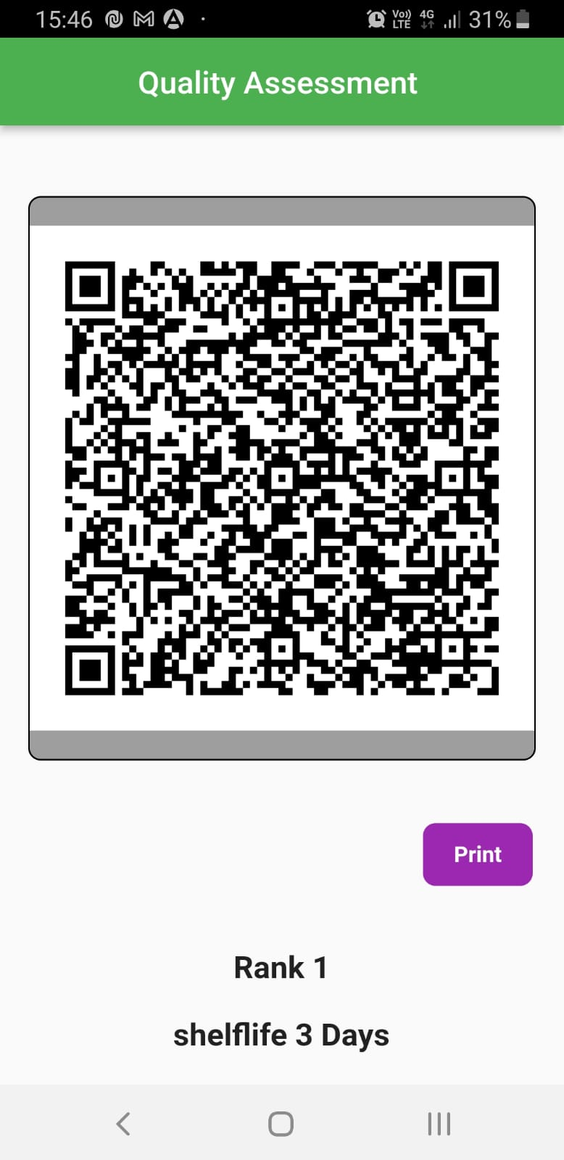
Solution (Contd…)
QR code with details for tracking quality
QR code can be printed and scanned later across supply chain to gather information on quality
A Decision Tree Algorithm (ML) based on text attributes prepared from given dataset, ranks the quality of produce on predefined criteria
You can scan the QR code to get required information
Submit to get QR code and Quality Rank (Score) and Shelf Life

Slide 10
Banana Quality Assessment (Case)
Image based Banana Quality Assessment Demo given in Video Link
Banana can be qualitatively assessed across several stages based on image taken (Visual Attributes)
Similarly vision receptive commodities will be replicated in the app in the next round
Underlying Deep Learning model created from open data available

Slide 11
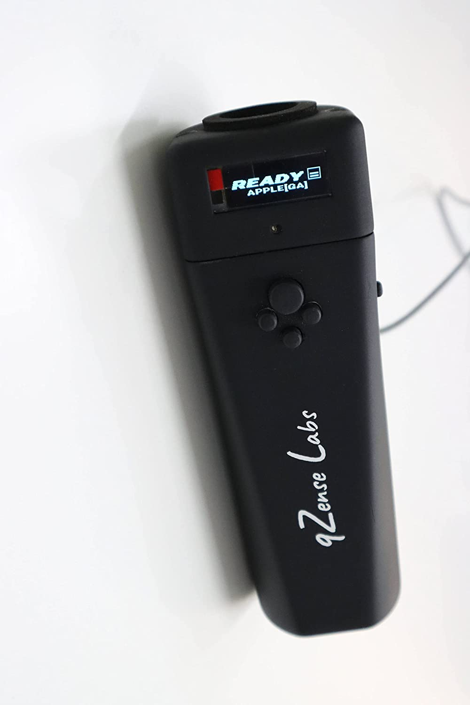
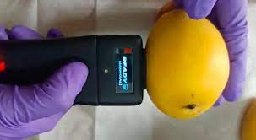
Features to be Added
e
Qscan, our near infrared quality scanning device ready for deployment and integration in the mobile application developed
Device assesses quality of fruits like mango, apples, citrus, papaya, avocado, pear, grapes, sapota, potato, Banana etc
Device measure brix value (sweetness), predicts stage of the fruit and determine shelf life

Slide 12
Features to be Added (Contd.)
Expand quality assessment across commodities
Vision based fish spoilage quality assessment
Development along cataloging and tracking
AI enabled chatbot/voice assistant

Slide 13
Demo Links
qZense Labs Quality Assessment
Qzense Labs Banana Quality Assessment App Demo Video
Qscan-external device for quality assessment demo

